Slide 1
Which City Had the Highest Level of NO2 Over the Last 40 Years?
TEAM 17

Slide 2
AIR QUALITY INDEX REPORT
DATA
EXPLORATORY DATA ANALYSIS
Time : 1980-2023 (Int)
CBSA (String)
Pollutants (Int | Float)
Identified densely populated cities
Picked the pollutant-Nitrogen dioxide (NO2)
Visualizing the pattern
REFERENCE: Core-Based Statistical Area Population Density, bimajority.org/~wollman/cbsa-pop_per_km2-2016-dens-order.html. Accessed 16 Sept. 2023.

Slide 3
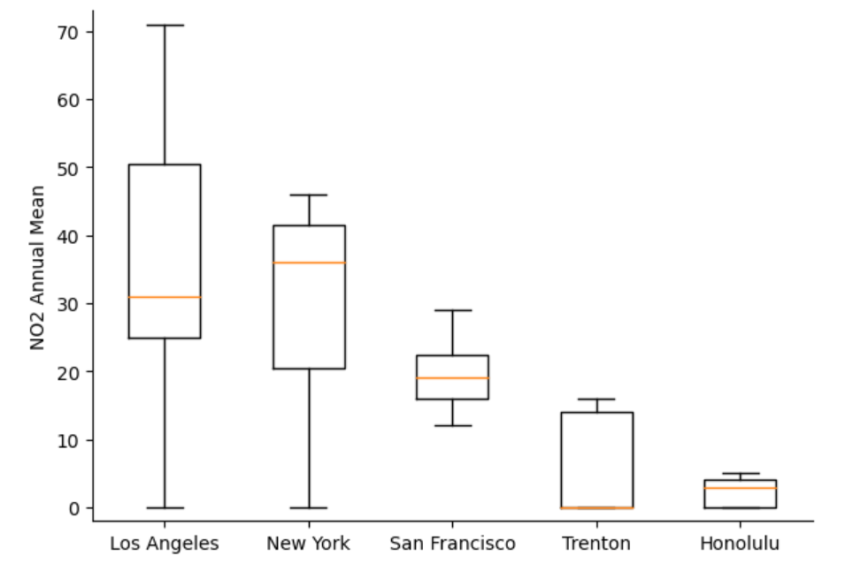
ANNUAL SPREAD OF NO2 PER CITY
Los Angeles highest NO2 value
Trenton highest variability
Honolulu lowest spread of NO2

Slide 4
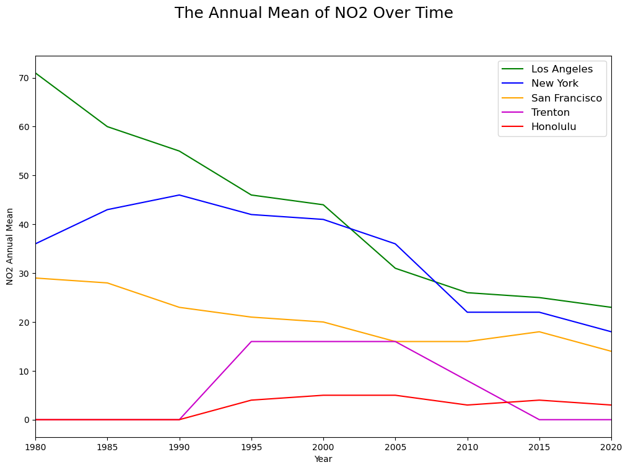
ANNUAL NO2 VALUE OVER TIME
Los Angeles has the highest NO2 value
Trenton NJ had a spike between 1990 - 2005
Overall Decline in NO2 Value

Slide 5
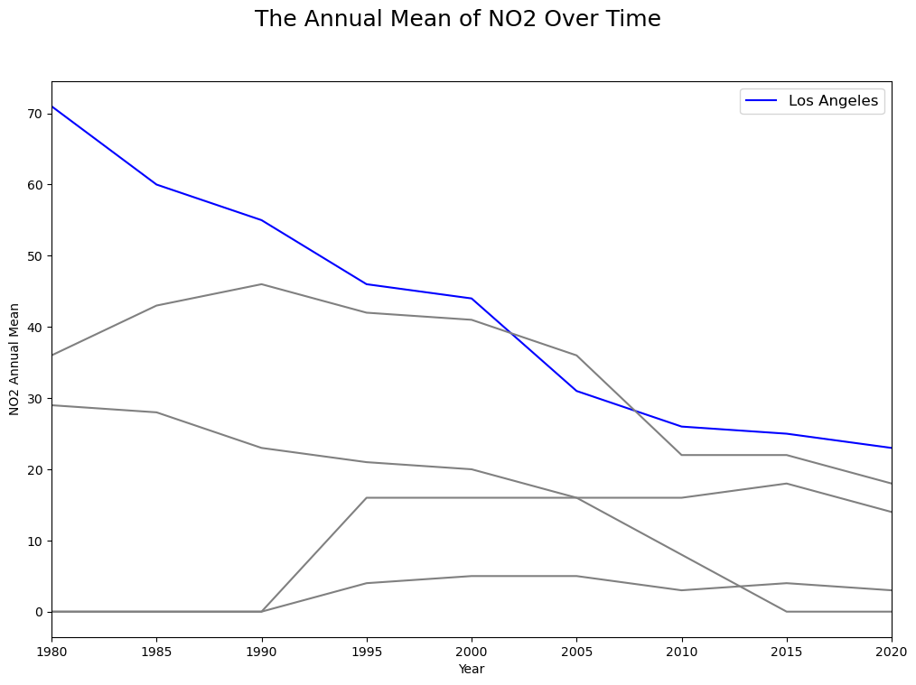
CONCLUSION
Los Angeles-Long Beach-Anaheim, CA highest NO2 value
Level of NO2 declined due to environmental regulations

Slide 6
REFERENCES
Allen, Jesse. “A Decade of Change for Nitrogen Dioxide.” NASA, NASA, 2014, earthobservatory.nasa.gov/images/87392/a-decade-of-change-for-nitrogen-dioxide#:~:text=In%20urban%20areas%20of%20the,motor%20vehicles%20and%20power%20plants.
Core-Based Statistical Area Population Density, bimajority.org/~wollman/cbsa-pop_per_km2-2016-dens-order.html. Accessed 16 Sept. 2023.

